Slide 2
Web Push Notification

Slide 3


Outline
What & Why?
Under the hood
How it works?
Let’s code

Slide 4
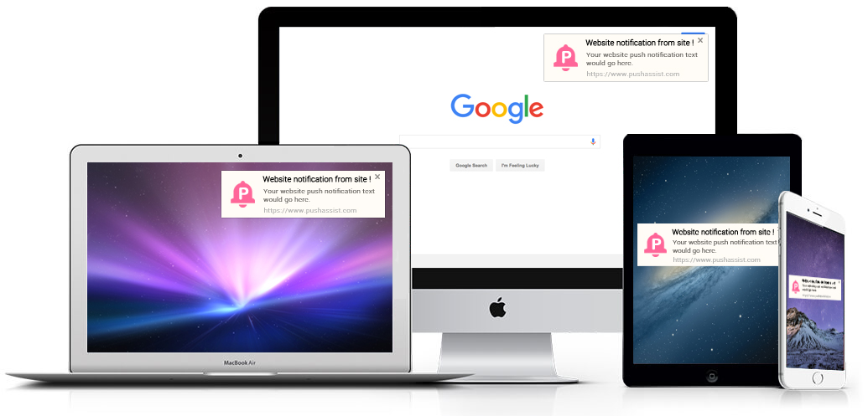
What & Why?

Slide 5
Under the hood
Service worker
Push Service
Chrome: Firebase Cloud Message (FCM)
Firefox: Mozilla Cloud Service (MCS)
Edge: Windows Push Notification Service (WNS)
Web Push Protocol

Slide 6

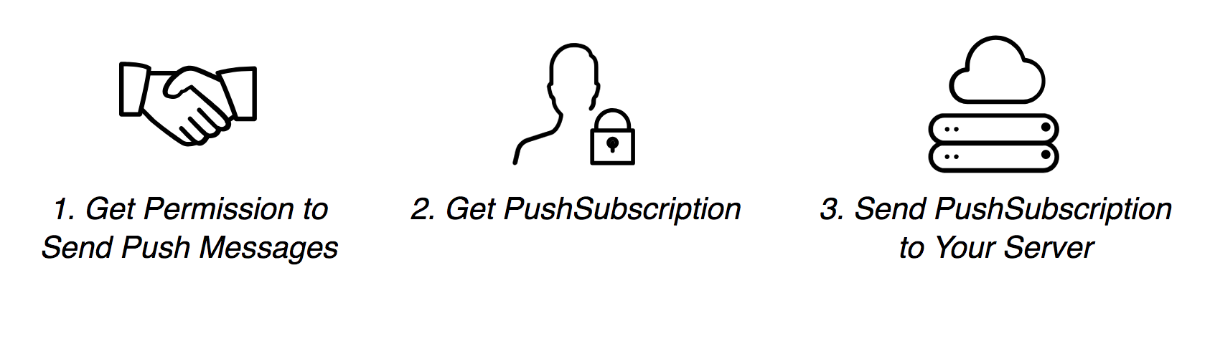
HOW IT WORKS
Get Subscription

Slide 7
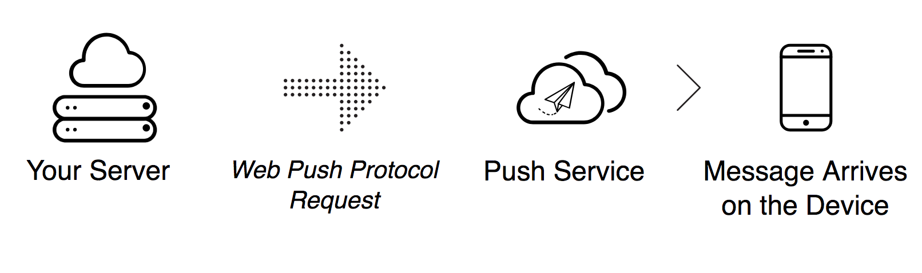
HOW IT WORKS
Send Push message

Slide 8
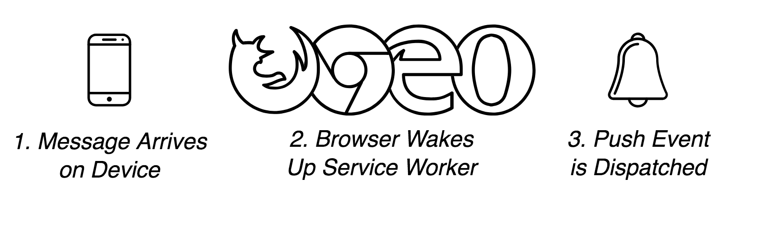
HOW IT WORKS
Push event to users

Slide 9

Let’s code

Slide 10
STEP 1
Detect browser support

Slide 11
STEP 2
Register a service worker

Slide 12
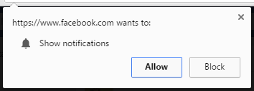
STEP 3
Request permission

Slide 13
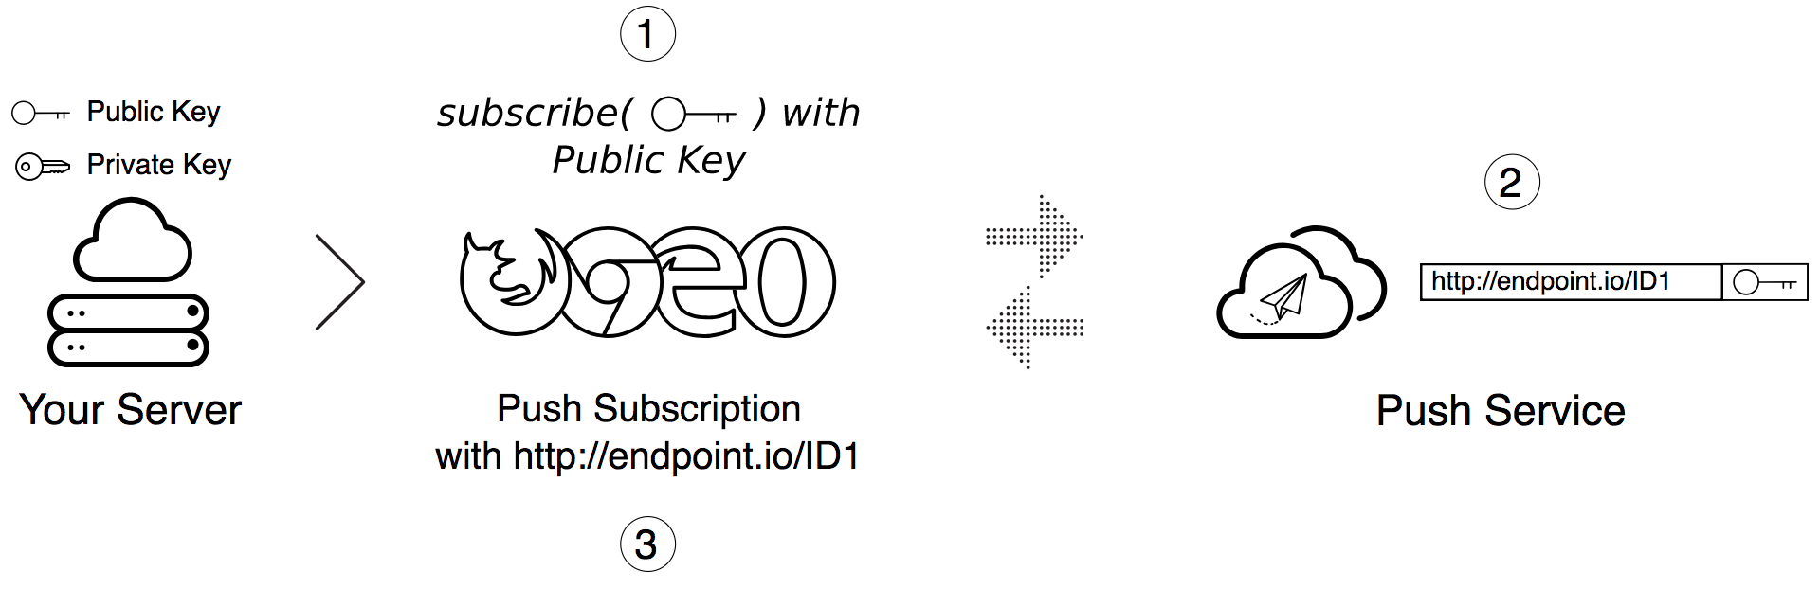
STEP 4
Subscribe user with Push Service

Slide 14
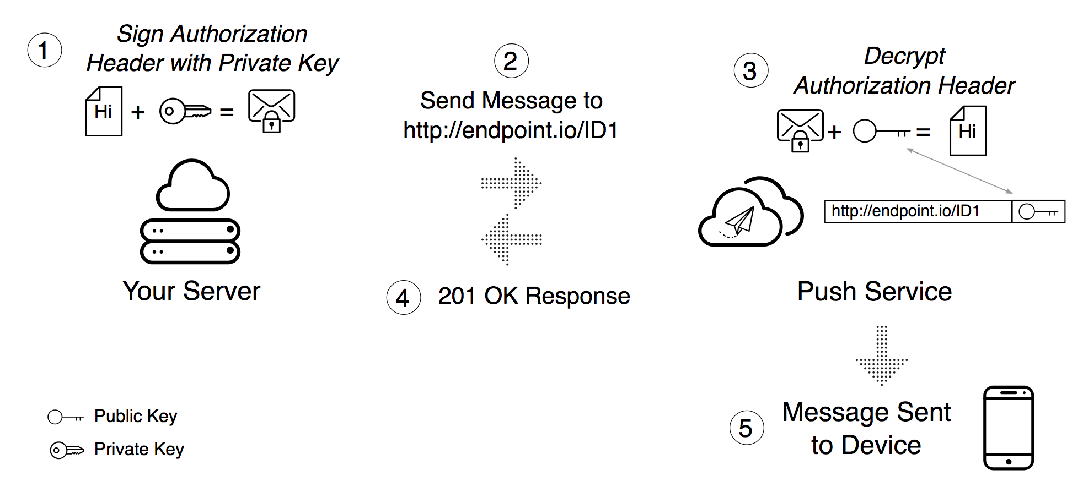
STEP 5
Send message to Push Service

Slide 15
STEP 6
Handle Push event

